Slide 1
AI for Mental Health
Prediction from Social Media

Slide 2
Project Title & Team Details
AI for Mental Health
Team Details :--
VANSH NAZVANI (23SCSE1040180)
KRISHNAKANT RAJPUT (23SCSE1040201) RAHIL (23SCSE1040122)

Slide 3
Problem Statement
Social media has become a window into people's emotional lives. Every day, millions share their feelings, struggles, and thoughts online.
Hidden within these posts are important signals—signs of stress, anxiety, and depression that often go unnoticed until it's too late.
Early detection through AI can bridge the gap between silent suffering and timely mental health support.

Slide 4
Objectives
Analyze Text : Use AI to study social media posts and comments for emotional patterns
Detect Early Signs : Identify indicators of sadness, stress, anxiety, and depression before they escalate.
Enable Support : Provide insights that can help individuals get the mental health support they need.

Slide 5
List of Tools and Technologies
Used

Slide 6
Technologies Used for AI-Based Mental Health Prediction System
Technologies used | Used for? | Description | Why used?
Python | Programming language | Core language used for data p,rocessing, machine learning, and model development. | Simple syntax, large AI/ML ecosystem, and excellent library support.
Machine Learning (ML) | Prediction & analysis | Algorithms used to analyze social media text and predict mental health-conditions such as | Enables automated pattern detection and accurate predictions from data
Natural Language Processing (NLP) | Text analysis | Processes and analyzes social media posts, comments, and captions. | Helps under₋stand emotions, sentiments, and psychological cues in text.
Scikit-learn | ML model development | Used for training, testing, and evaluating machine learning .models. | Easy₋-to-use, efficient, and suitable for text classification task₋s.

Slide 7
Additional Technologies
Technologies used | Used for? | Description | Why used?
TensorFlow | Deep- Learning | Complex neur₋al network models banane ke liye deep learning capabilities provide | Social media text me hidden emotional patterns ko accurately detect karne ke liye powerful framework.
Data manipulation & numerical | Social media data ko clean, process aur | Used for secure user authentication and session management. | Fast data handling, missing values removal, aur ML model ke liye data preparation easy hota hai
Streamlit | ML model ke results dikhane | Development and build tool for faster frontend bundling. | Extremely fast startup time and optimized build performance.

Slide 8
Key Features
Social Media Text Analysis - Analyzes user-generated content from social media
platforms using Natural Language Processing (NLP) techniques to detect emotional and psychological patterns.
Mental Health Condition Prediction - Utilizes machine learning and deep learning models to predict mental health conditions such as depression, anxiety, and stress.

Slide 9
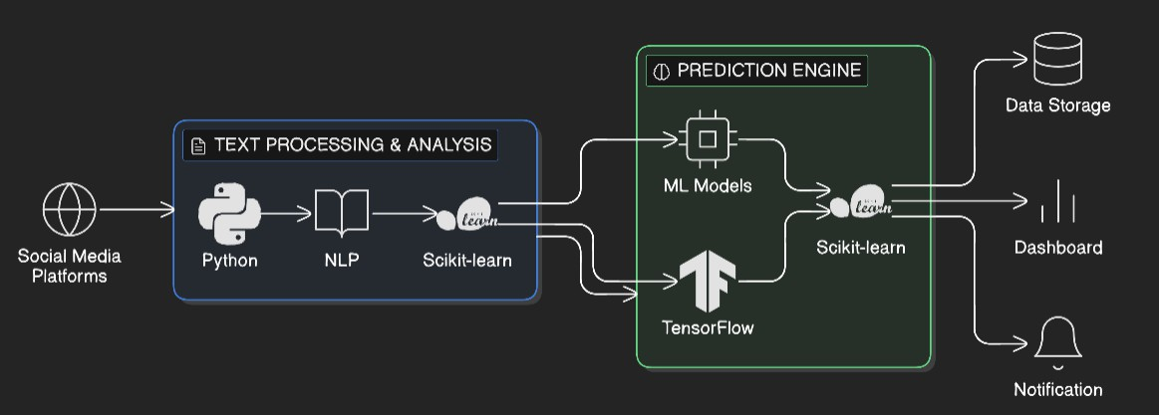
System Architecture

Slide 10
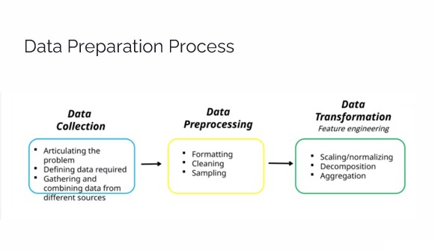

Slide 11
Current Status of Implementation
Machine Learning and Deep Learning models using Scikit-learn and TensorFlow have been successfully trained, tested, and integrated with the backend.
Natural Language Processing (NLP) techniques for text preprocessing, sentiment analysis, and feature extraction are fully implemented and working correctly.
The frontend is developed using Streamlit , providing a user-friendly interface for text input and real-time mental health prediction display.

Slide 12
Future Enhancements
Multilingual Support : Expand the model to work with multiple languages including Hindi, Spanish, and others—making mental health detection accessible globally.
Visual Analysis : Add capability to analyze images, emojis, and visual content that users share—capturing emotional signals beyond just text.
Full Web Platform : Develop a comprehensive web-based application with user accounts, history tracking, and resources for mental health support.

Slide 13
Thank you
Team Details :--
VANSH NAZVANI (23SCSE1040180)
KRISHNAKANT RAJPUT (23SCSE1040201) RAHIL (23SCSE1040122)

